Slide 1
MOBILE DEVELOPMENT
BY:
NAAJIYAH SOOBRATTY

Slide 2
Functionalities
Registration and Login
List of Restaurants
Call option
Search Restaurants by name or location
Menu List
Rate Restaurant

Slide 3
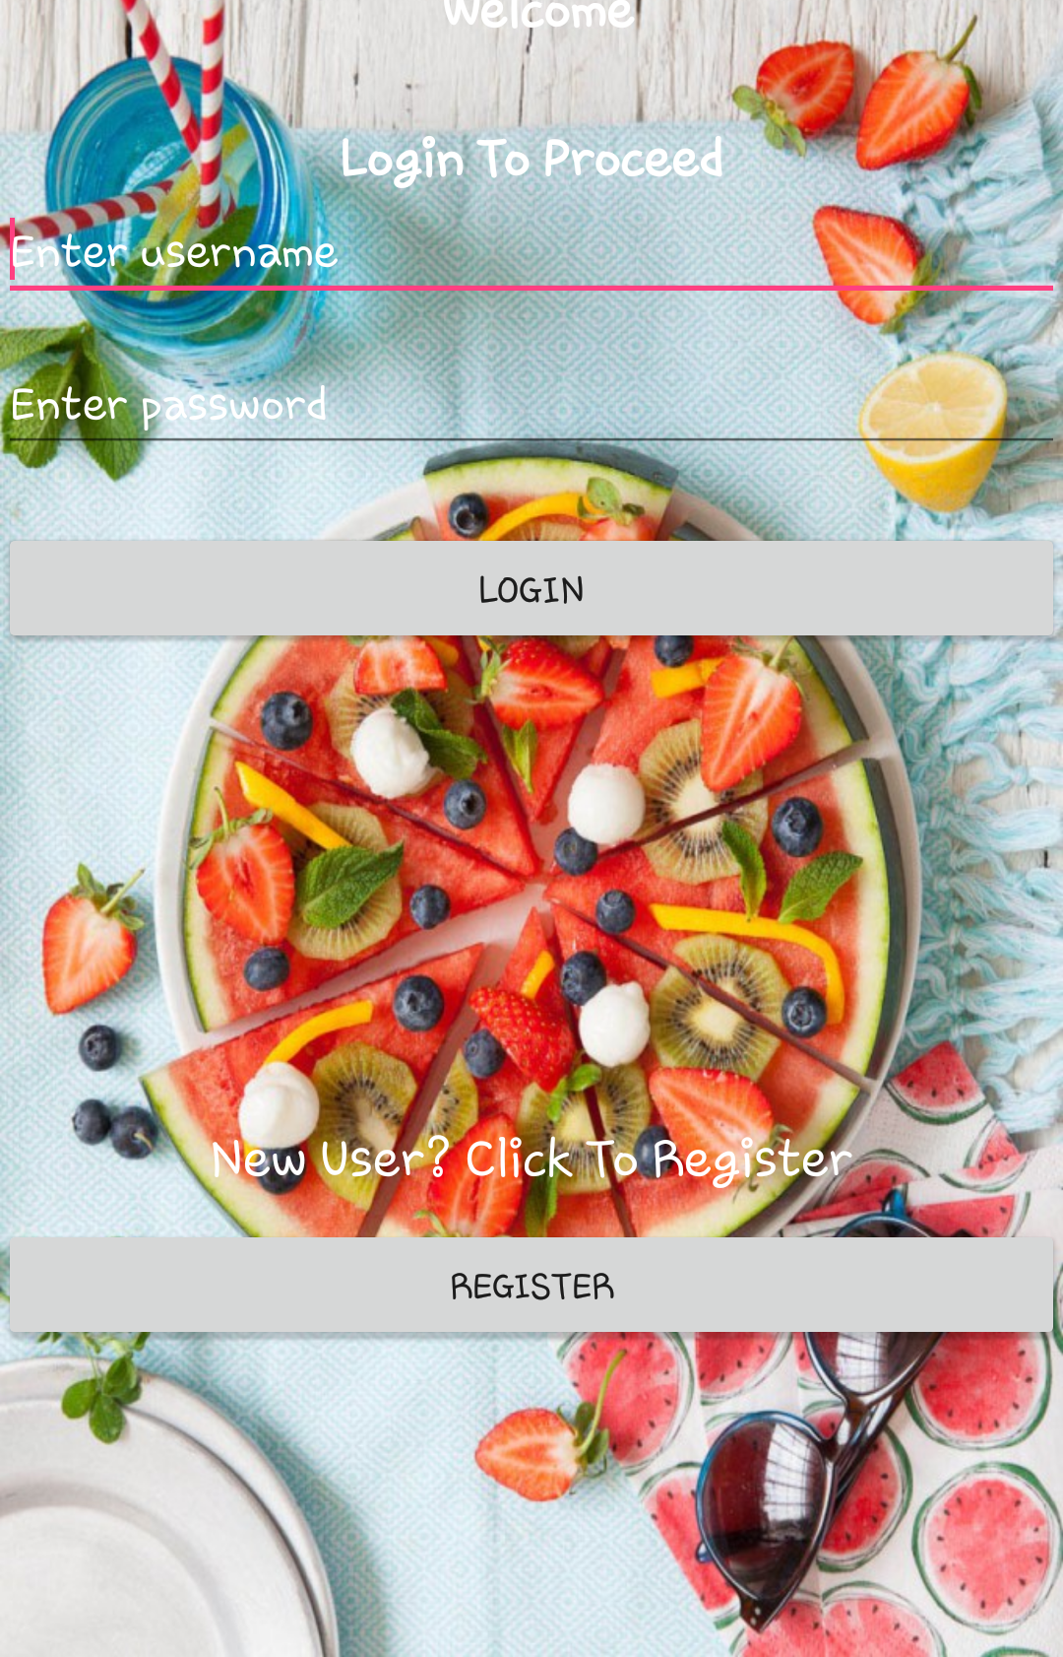
Username and password using EditText ( Hint to display message)
Login button redirected to dashboard if user exists(using intent)
Toast message upon wrong login information
Registration for new users, redirecting to registration page

Slide 4
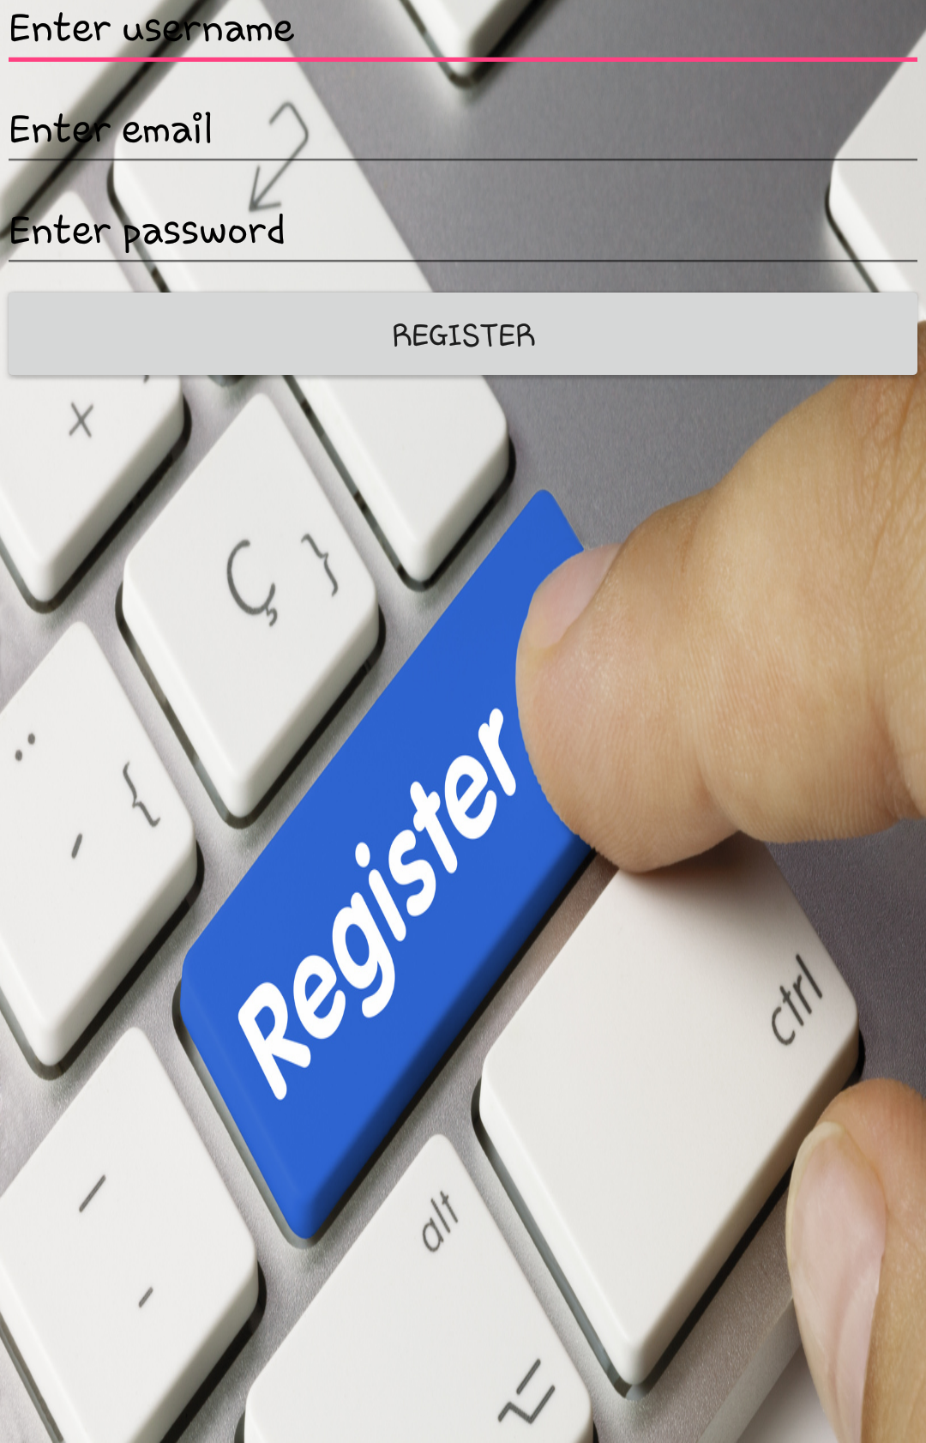
Username,email and password field using EditText with hint to display message
Registration button to insert new user in database and redirect to dashboard page ( using intent)

Slide 5
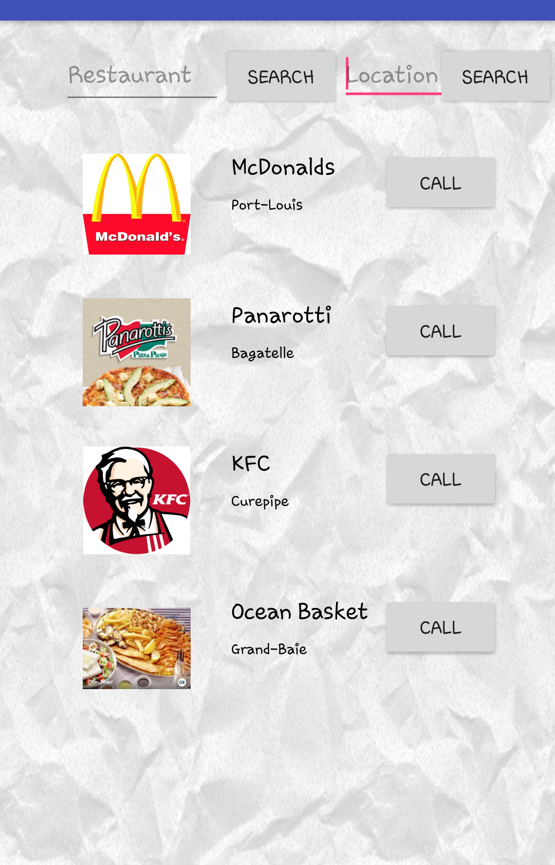
RecyclerView to display list of restaurants with image icon and descriptions ( name and location)
Search Restaurants by name or location functionality using EditText and button.
Restaurant name upon clicking redirects to menu page ( using Intent)
Call option redirecting to phone dial pad
Scrolling of Restaurant list

Slide 6
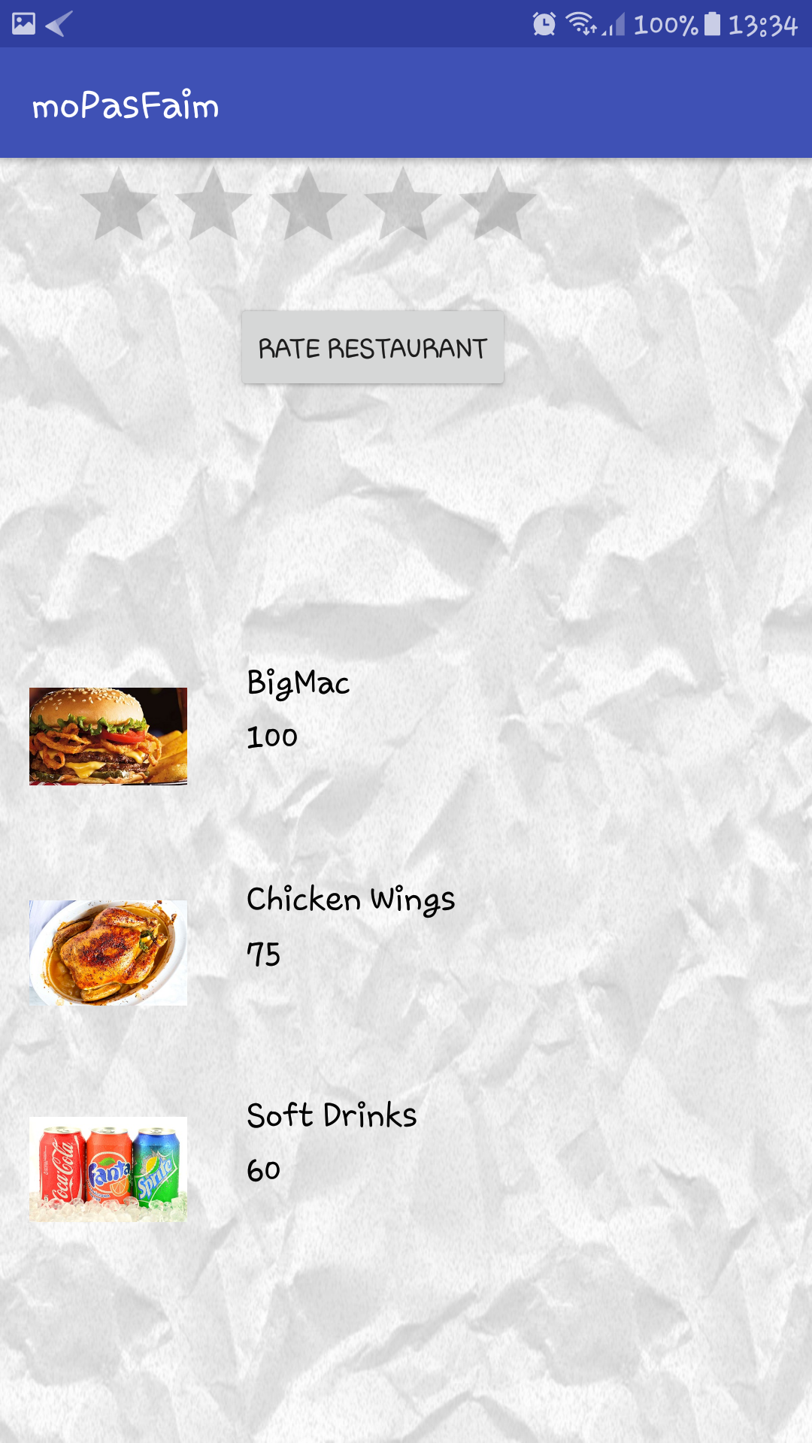
Menu list using recyclerView
Menu list customized for each restaurant using Intent and getExtra
Rate restaurant using rating bar and button, inserts rating into Ratings table.
Ratings table include restaurant ID, user ID and ratings

Slide 7
Thank you!

